Slide 1
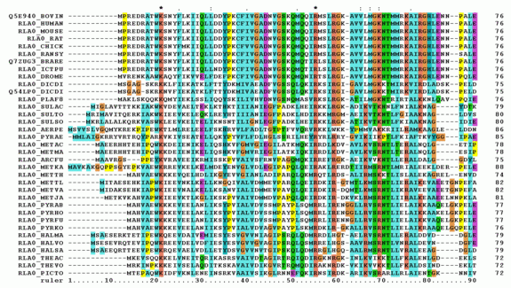
Multiple Sequence Alignment
- a quick overview -

Slide 2
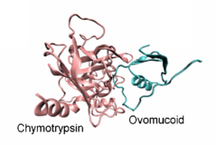
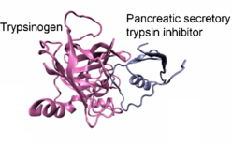
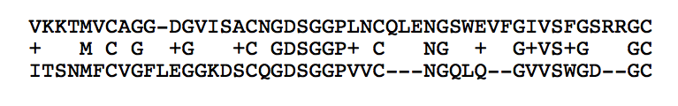
Motivations for sequence alignment
1) find genes that are related by common descent
Chymotrypsin
[…]
Trypsinogen
[…]

Slide 3
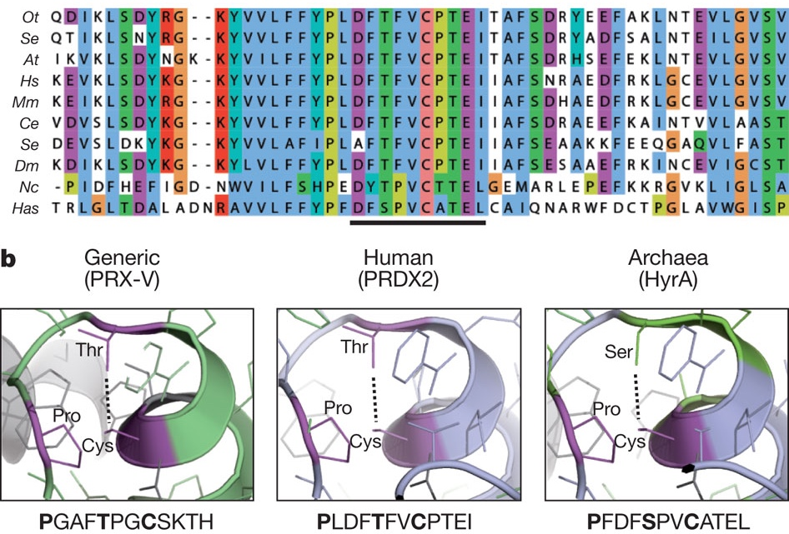
Motivations for sequence alignment
2) to identify and check the state of “active sites”
From: Peroxiredoxins are conserved markers of circadian rhythms. Nature 485, 459–464 (24 May 2012)
Notes:
Figure 1: The peroxiredoxin active site is highly conserved in all domains of life.
a, Multiple sequence alignment showing peroxiredoxin amino acid sequences. The highly conserved active site is underlined. Representatives shown from Eukaryota (At, A. thaliana; Ce, Caenorhabditis elegans; Dm, D. melanogaster; Hs, Homo sapiens; Mm, M. musculus; Nc, N. crassa; Ot, O. tauri; Sc, S. cerevisiae), Bacteria (Se, S. elongatus sp. PCC7942) and Archaea (Has, H. salinarum sp. NRC-1). b, Critical residues in the active site of 2-Cys peroxiredoxins (in bold) are conserved in all organisms. Structures were derived from human PRX-V (Protein Data Bank (PDB) accession 1HD2)⁴⁷ and human PRDX2 (PDB accession 1QMV)⁴⁸, and modified with PyMOL to show the predicted structure for archaeal peroxiredoxin (HyrA, GenBank accession NP_280562.1).

Slide 4
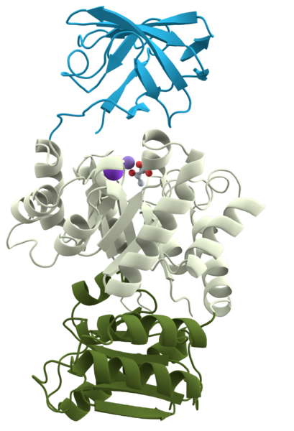
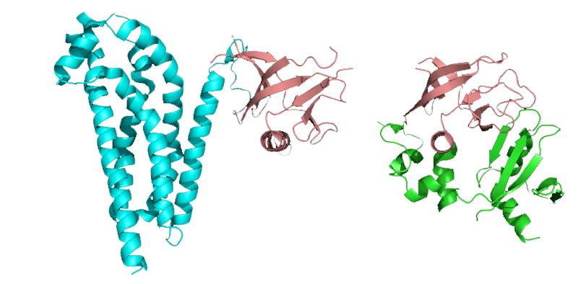
Motivations for sequence alignment
3) to identify and characterize “protein domains”
definition:
“parts of proteins that can
evolve, function, and exist
independently of the rest”
PH
PH
“PH”-domain (pink);
occurring in two different proteins
Pyruvate Kinase

Slide 5
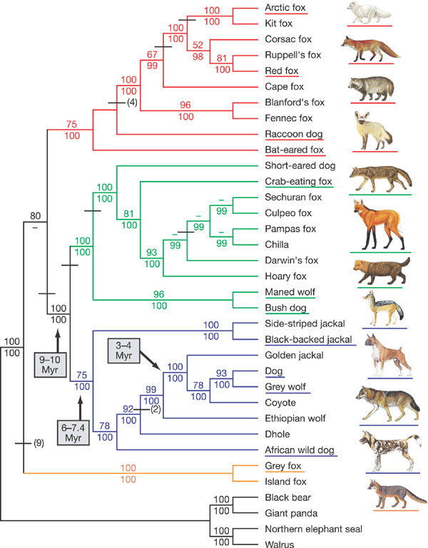
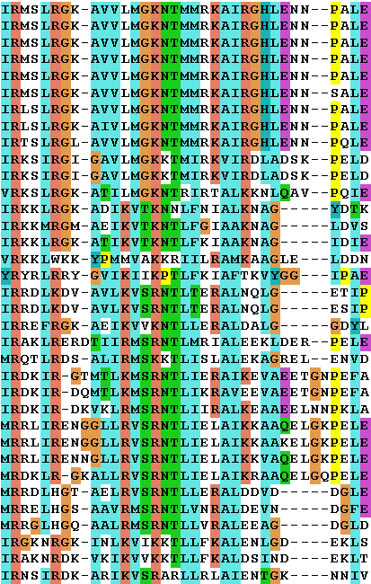
Motivations for sequence alignment
4) to make phylogenetic inferrences (“trees”)
canine 1
canine 2
canine 3
[…]

Slide 6
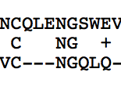
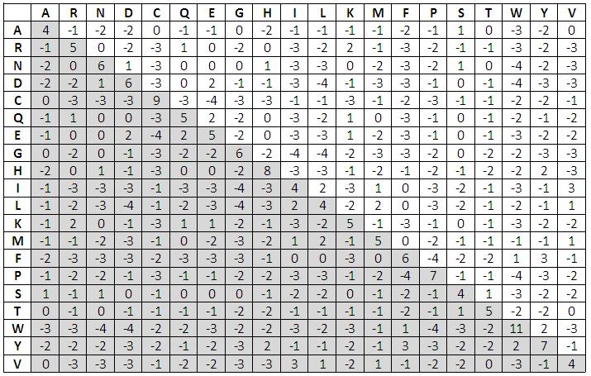
How it’s done …
Chymotrypsin
[…]
Trypsinogen
[…]
=> “substitution matrix” (learned from structures)
Why not align “QL” instead of “NG” ??
What does the “+” mean ?
How “good” is my alignment?

Slide 7


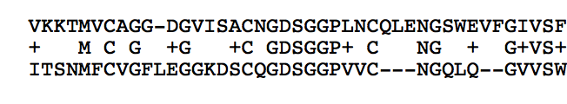
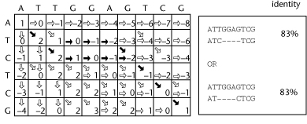
Pairwise Alignment
a) BLAST: quick and dirty
1) identify word-matches (use indexing)
2) extend into an “HSP” (high-scoring sequence pair)
b) Dynamic Programming – correct and slow
explore all possible paths
(but excluding obvious dead ends)

Slide 8
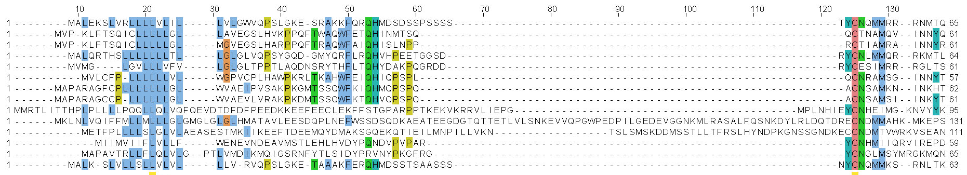
Multiple Alignment
Combinatorial Explosion: very many possible solutions
Complexity: O(alignment_length )
=> an NP-complete problem !!
number_seqs

Slide 9



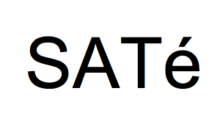






Multiple Alignment

Slide 10
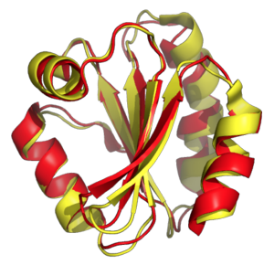
Quality of MSA: Benchmarking
“BAliBASE”:
Benchmark Alignment Database
Hand-made multiple sequence alignments
Based on selected structural alignments
Structural Aligments
offer the best
benchmarks !

Slide 11
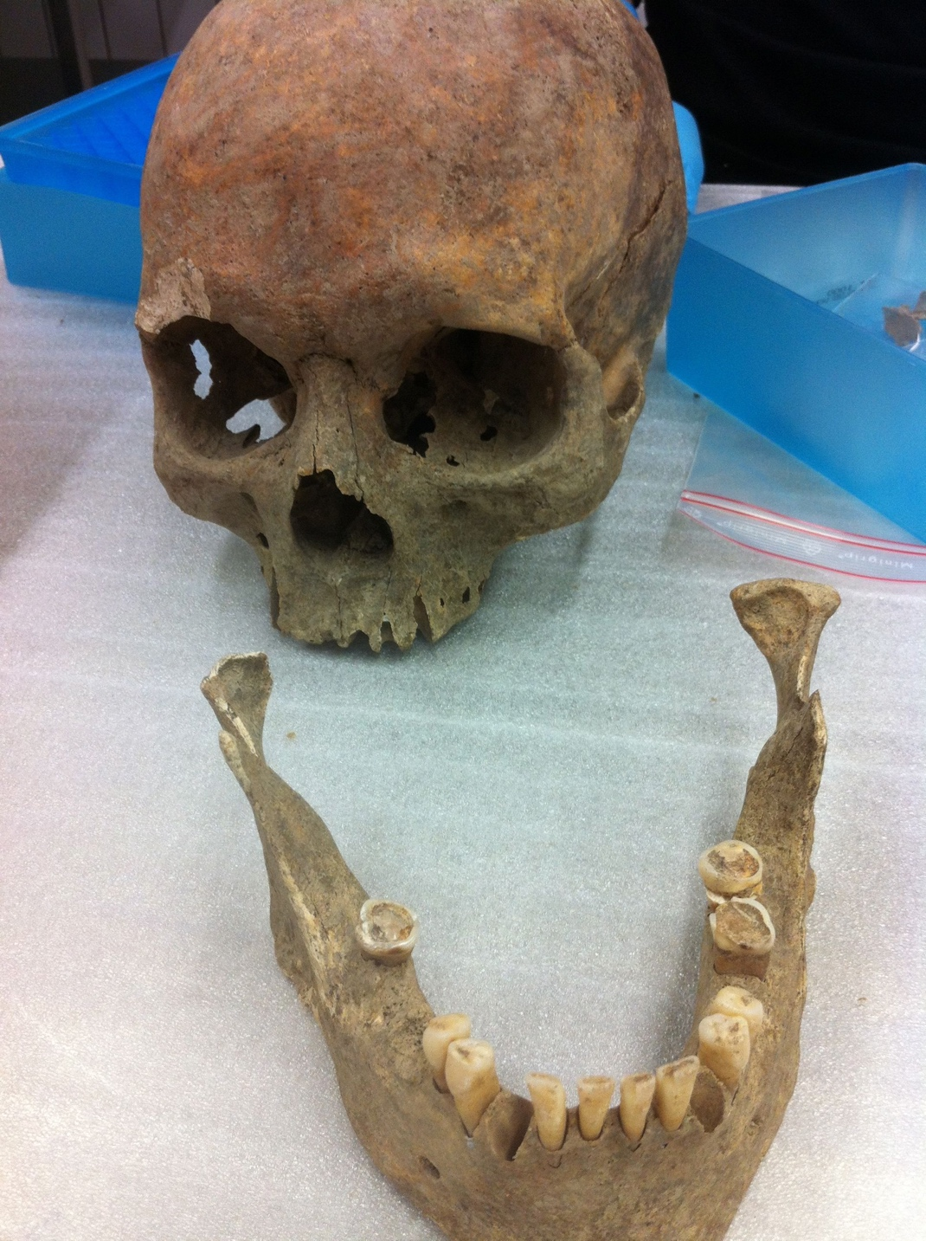
Practical Session: Source of your Sequences
Dental Calculus of
Medieval Mummy
(with kind permission of
Christina Warinner, UZH)
bonus material in 2021:
COVID-19 sequences !

Slide 12
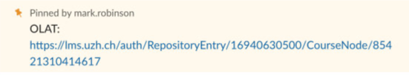
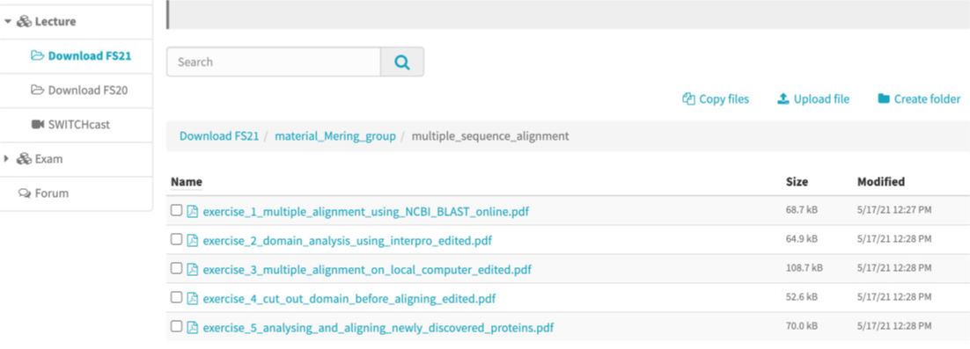
Exercise Instructions: on OLAT

